Slide 1
History of dormitories
Powered by Burnashev Dmitry

Slide 2
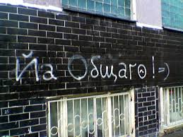
Generally

Slide 3
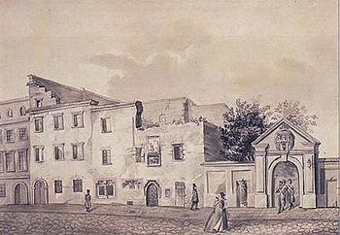
First dormitories

Slide 4
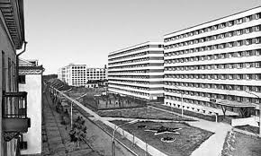
Soviet hostels

Slide 5
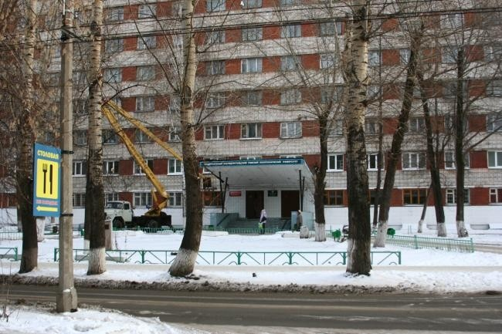
Dormitories Now

Slide 6
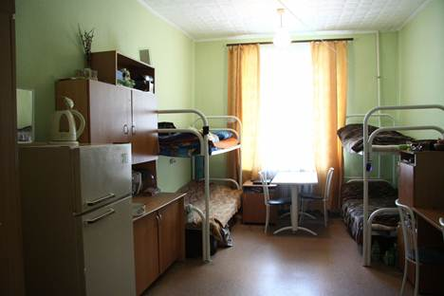
the student's hostel

Slide 7
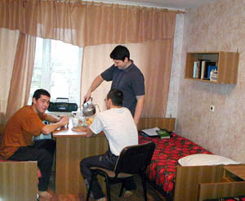
a hostel for workers

Slide 8
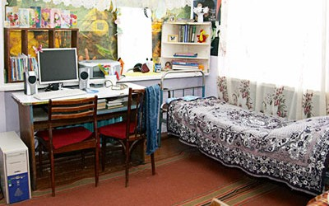
small-family hostels

